Slide 1
MACHINE LEARNING BASED AUTISM PREDICTION IN CHILDREN
DONE BY
2019202027-S.KISHORE
UNDER A GUIDANCE OF
DR.P.GEETHA

Slide 2
ABSTRACT:
Recent Studies indicate that autism is a brain growth related disorder.
Due to the structural and functional connectivity issues, the persons with ASD has impact in making relationship and communication with others.
Small and repeated conduct patterns are also seen in the disorder.
machine neural network efficiency is strong in many applications. In this project, we propose a convolutional neural network (CNN) to detect the autism children in earlier life cycle stage.
In this work the face images from normal controls and ASD controls. These images are processed using Gray level co-occurrence (GLCM) and CNN .
The Classification Accuracy are analyzed and compared and finally CNN is proven as best method.

Slide 3
PROBLEM STATEMENT:
ASD is one of the prevalent diseases influencing the language and also the social actions of individuals.
Accurate medical diagnosis of autism is a complicated as it has a wide spectrum of variations in signs and severities and each type of autism has its own comorbidities.
machine neural networks have been witnessed in several separate implementations of visual data processing and achieved strong efficiency.

Slide 4
TOOLS:
PYTHON,JUPYTER NOTEBOOK
ALGORITHM USED:
CONVOLUTIONAL NEURAL NETWORK:
A Convolutional Neural Network (ConvNet/CNN) is a Deep Learning algorithm which can take in an input image, assign importance (learnable weights and biases) to various aspects/objects in the image and be able to differentiate one from the other.
GRAY LEVEL COOCCURENCE MATRIX:
The GLCM functions characterize the texture of an image by calculating how often pairs of pixel with specific values and in a specified spatial relationship occur in an image, creating a GLCM, and then extracting statistical measures from this matrix.

Slide 5
PROPOSED SYSTEM:
In this method CNN classifier is used for detection of autism from thermal images. The result of CNN shows higher classification performance than other classifier. And CNN technology will be used in feature extraction and training.
The steps involved are
1) Training – In training all the collected images are trained to the model and all necessary features are extracted and stored in the database.
2) Classification – After training, the CNN will classify the given new input as either normal child or abnormal child.

Slide 6
MODULES:
1.IMAGE ACQUISITION:
Image acquisition is the action of retrieving an image from a source, usually hardware systems like cameras, sensors, etc.
Here we are loading children image as a dataset for the process.
2.PREPROCESSING:
Preprocessing are the steps taken to format images before they are used by model training and inference. This includes, but is not limited to, resizing, orienting, and color corrections.
In this module the given input image is converted into grey format.
We need to check any external noise is present.
If its present that noise has to be removed by median filter.
Then the Image is enhanced and sent for segmentation
3.SEGMENTATION:
Segmentation is the division of an image into regions or categories, which correspond to different objects or parts of objects. Every pixel in an image is allocated to one of a number of these categories. Here GLCM algorithm is used. In this module the given image is been segmented.
We will segment the image as high and low clusters based on density and threshold.
This is done by Fuzzy C means Clustering algorithm process.

Slide 7
Feature Extraction:
In this module the features such as amplitude, contract, brightness, entropy, mean, median etc are been extracted and analyzed.
CLASSIFICATION:
The process of categorizing and labeling groups of pixels or vectors within an image based on specific rules. The categorization law can be devised using one or more spectral or textural characteristics. Two general methods of classification are 'supervised' and 'unsupervised’.
Here we are using convoulutional neural network(CNN) algorithm . This algorithm will help in finding out whether the child is normal child or autism child.

Slide 8
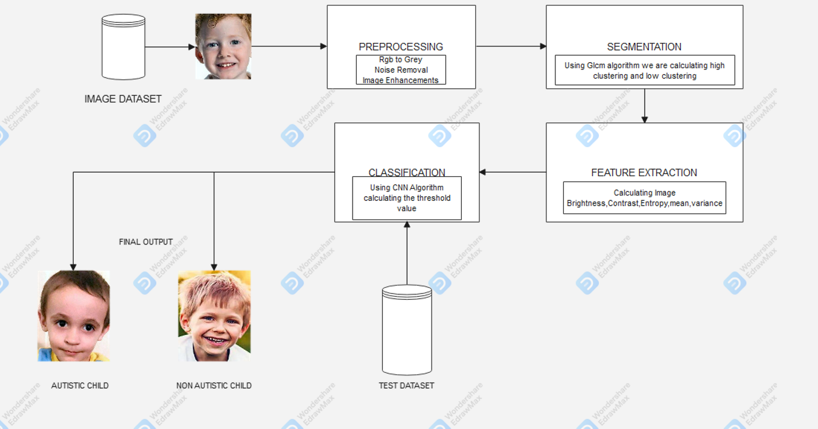
Architechture diagram:

Slide 9
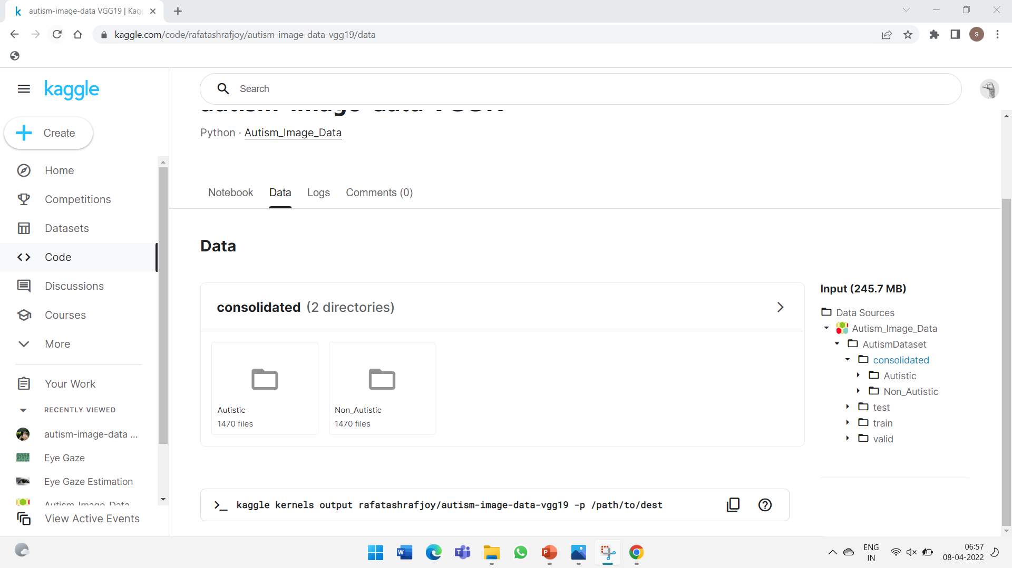
Dataset:
Children images from Kaggle

Slide 10
